Slide 1
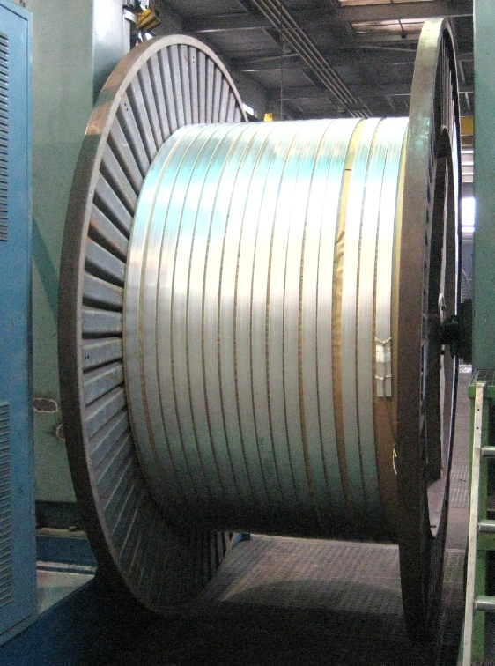
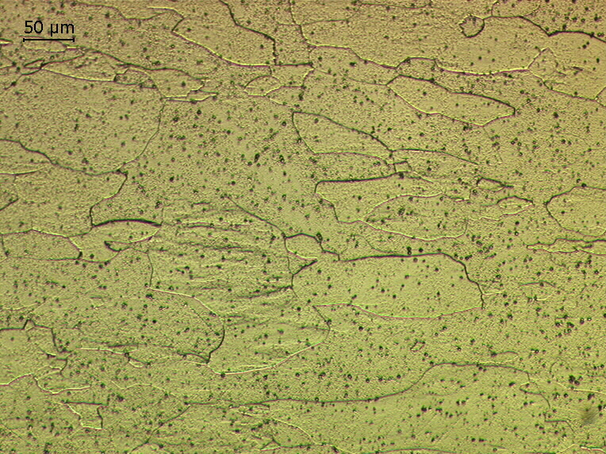
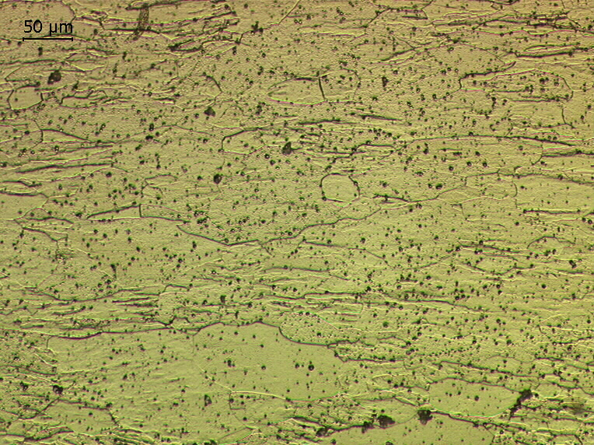
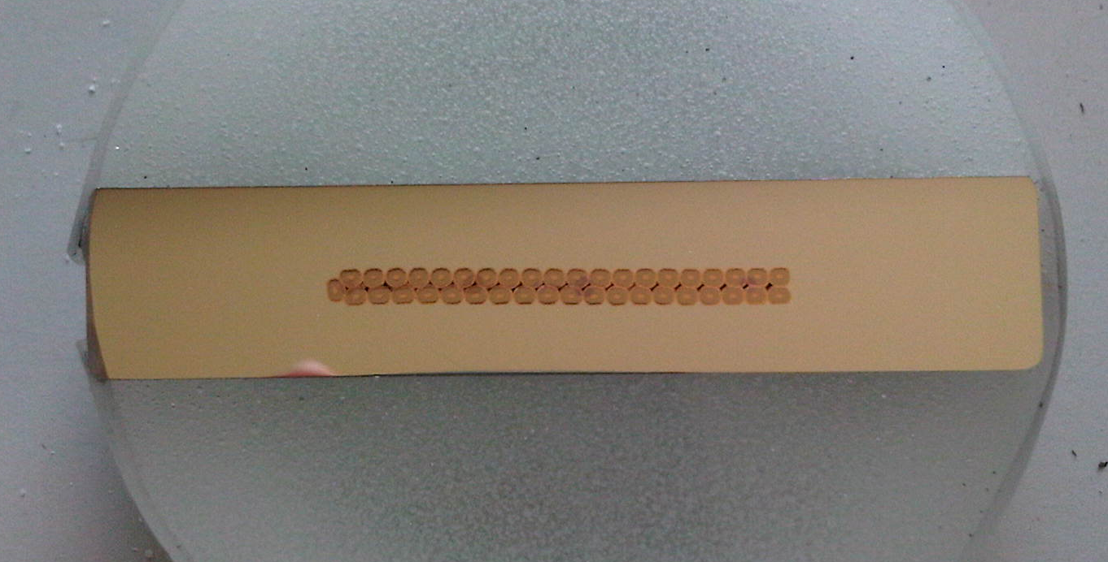
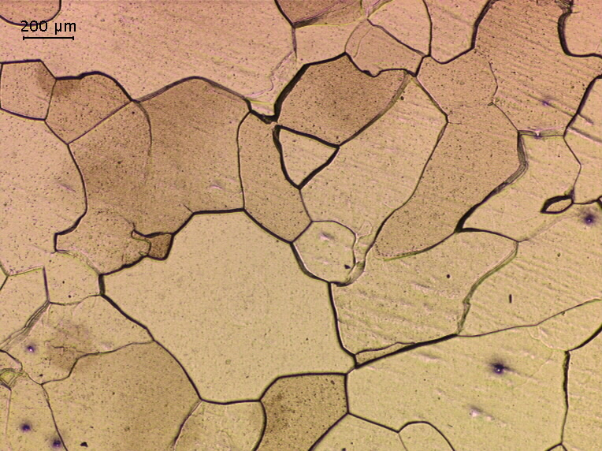
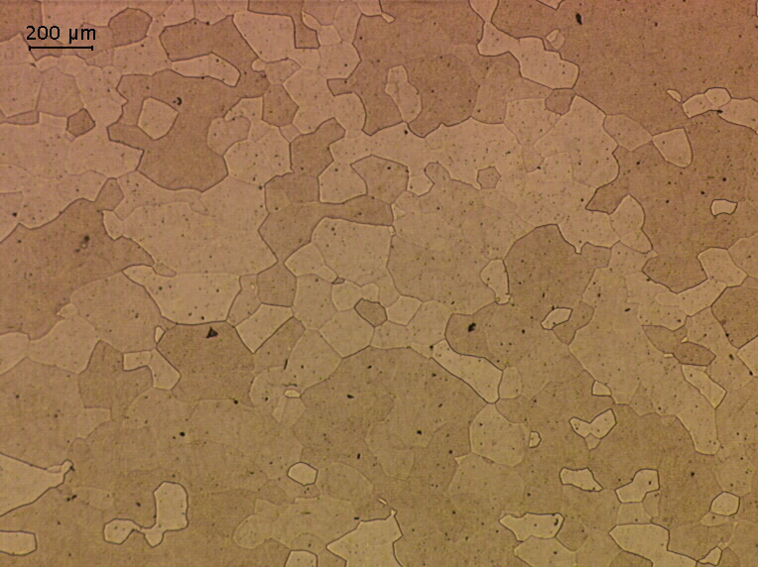
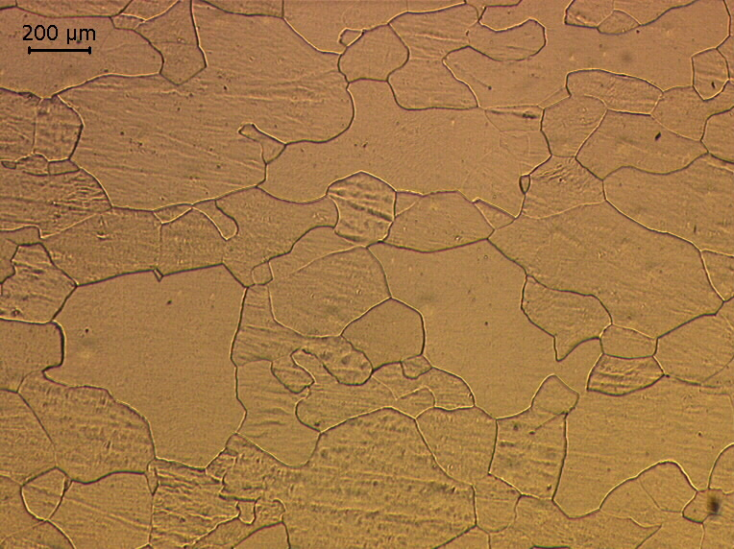
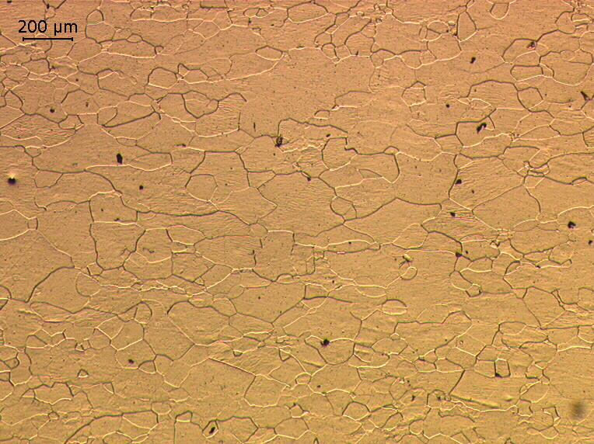
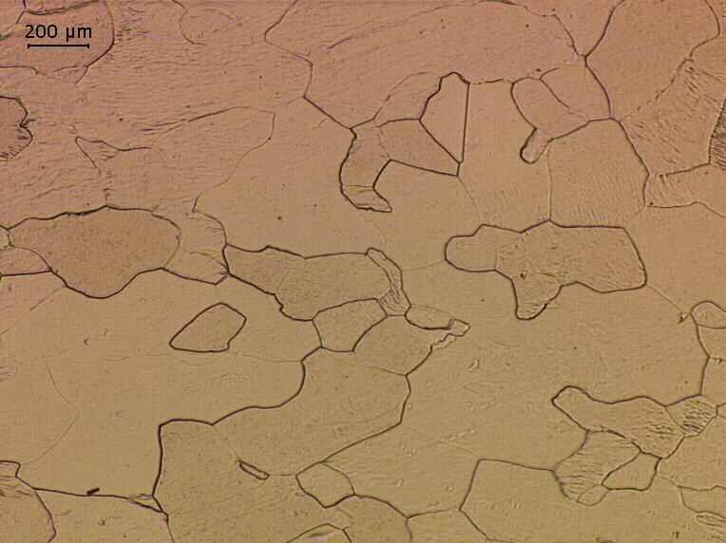
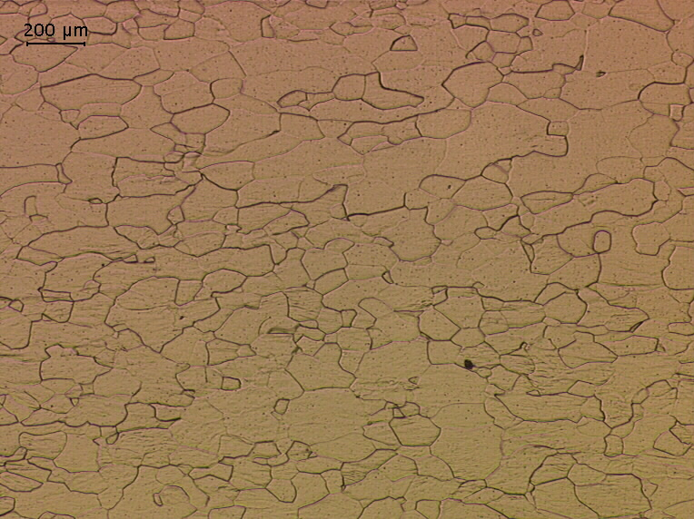
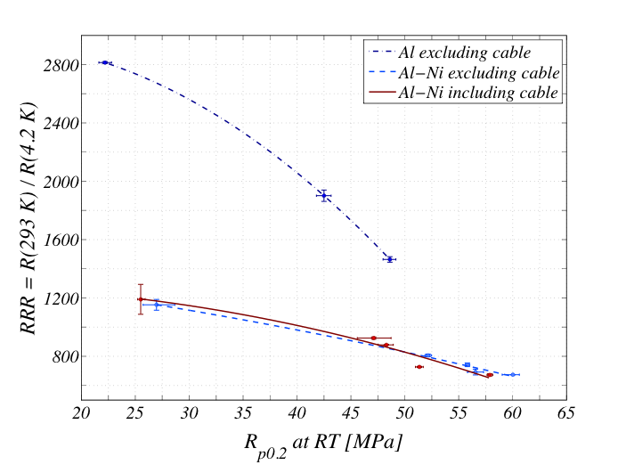
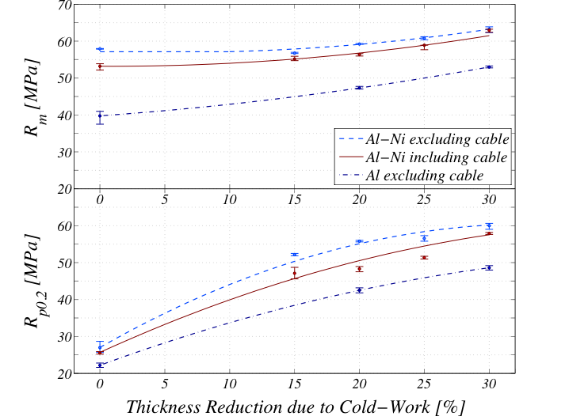
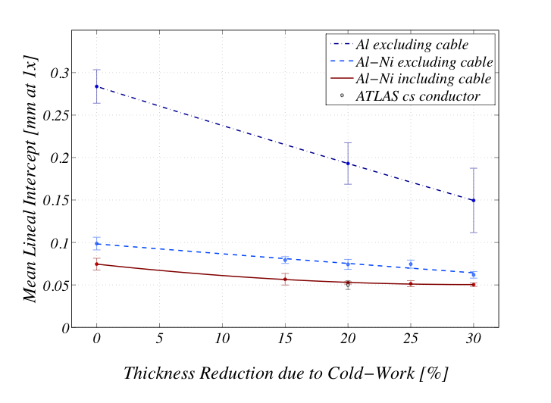
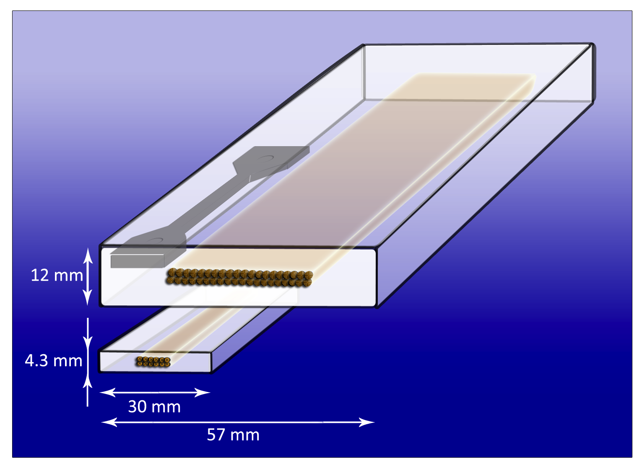
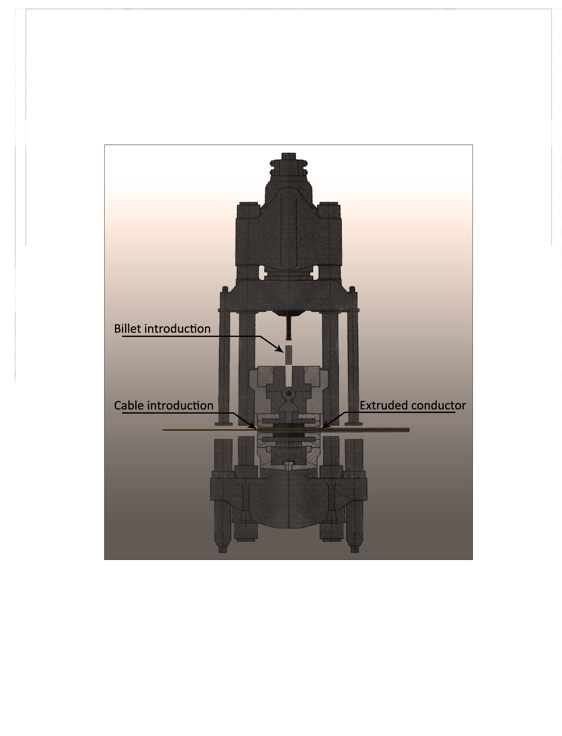
Characterization of large size co-extruded Al-Ni stabilized Nb-Ti superconducting cable
Stefanie Langeslag^{1,2}, Benoit Cure¹, Stefano Sgobba¹, Alexey Dudarev¹, Herman ten Kate^{1,2}
CERN, CH-1211 Genève 23, Switzerland
University of Twente, POB 217, 7500 AE Enschede, The Netherlands
Background
Conclusion
Future detector magnets call for the development of next generation large size Al stabilized Nb-Ti superconducting cables exhibiting high yield-strength for coping with the large stress in wide bore magnets with peak magnetic fields up to 6 T, while avoiding significant degradation in Residual Resistivity Ratio (RRR). A precipitation type alloy obtained by dilute-alloying of high-purity Al with a Ni additive, can feature a yield strength up to 110 MPa at 4.2 K when used as stabilizer material for small cross-sectional conductors.
A successful new co-extrusion of a record size, 57 x 12 mm², Al-0.1wt%Ni stabilized superconductor has been realized.
The Al-Ni alloy extruded with Rutherford cable exhibited in the highest cold worked state of 30% an R_{p0.2} of 58 and RRR of 673, which will result in an R_{p0.2} of 87 MPa at 4.2 K.
A new, 60 kA at 5 T class conductor has been realized, exhibiting in the as-drawn state, 30% cold-worked, a cross-sectional area of 8.5 x 61.5 mm² and a yield strength of 87 MPa at operating temperature.
The values are slightly lower than the gross of measurements conducted on Al-0.1wt%Ni extruded in smaller cross-sections in the development of the ATLAS and CMS solenoid conductor.
A cautious conclusion to be further verified is that increased cross-section extrusions result in decreased work hardening effects.
Objectives
New co-extrusion of a 40-strand superconducting cable with a precipitation type Al-0.1wt%Ni alloy, to a record cross-section size of 57 x 12 mm².
Conductor work-hardening up to 30%, and subsequent mechanical, electrical and optical characterization.
Methods
Large size Co-Extrusion
Experimental Procedures
Samples
Dimensions
Sample Extraction
An experimental extrusion is set-up at Nexans, Cortaillod (CH), using the extrusion die of the ATLAS barrel toroid conductor.
Work hardening is applied with use of actively driven rollers in one direction, the short transverse. A maximum thickness reduction of 30% is realized with intermediate sample extraction at 15, 20, and 25%.
Microstructural analysis:
Transverse plane, full cross-section
RRR measurement:
2 x 2 x 110 mm³; voltage taps at 80 mm
Tensile measurement:
3 x 3 mm² cross-section
25 mm calibrated length
Billets of Al-0.1wt%Ni and 5N-grade high-purity Al are used for the billet on billet continuous extrusion process.
A record size Al-Ni with 40-strand cable co-extrusion of 57 x 12 mm² is realized.
Three material variants:
5N-Al without cable; Al⁻
Al-0.1wt%Ni without cable; Al-Ni⁻
Al-0.1wt%Ni with cable; Al-Ni⁺
Tensile tests are performed at room temperature, on each material variant for each work hardened state.
Transport characteristics are determined by RRR measurements, here defined as R_{293 K}/R_{4.2 K}.
Microscopy images show the microstructure of the 30% cold-worked, co-extruded material in the bulk section (left) and in the proximity of the cable (right). The difference in microstructure increases with increasing cold-work.
All measurements described are conducted on the bulk section of the extruded conductor, to ensure a predictive capacity for future larger size stabilized conductors.
Results
Mechanical and Resistivity Characteristics
Changes in Microstructure
0.2% Yield strength, R_{p0.2}, increases in an almost linear manner with thickness reduction due to cold work.
Notice the slightly lower mechanical properties of the Al-Ni⁺ alloy with respect to the alloy without cable for higher work hardened states.
This difference may indicate an effect of the Rutherford cable on the work hardening process.
0% CW
5N-Al
Al-0.1%Ni
20% CW
30% CW
RRR in relation to 0.2% yield strength for the various different extruded material variants at the various cold worked states.
Increasing the 0.2% yield strength with use of work hardening has a less detrimental effect on the RRR of the Al-Ni alloy as it does on the RRR of the high purity Al.
Grain size as function of work hardened state for the three extruded material variants. Grain sizes show to decrease with work hardening extent.
Notice the close to equi-axed grains in the 0% CW case and the slightly compressed grains in the case where thickness reduction has taken place.
Tensile properties of the Al⁻ conductor, the Al-Ni⁻ conductor, and the Al-Ni⁺ conductor for five different cold worked states. The legend holds for both subplots.
Microstructure images of the 5N-Al extruded stabilizer (left) and Al-0.1wt%Ni extruded stabilizer (right) at various thickness reductions.
Presented at the Applied Superconductivity Conference , 2012 Oct. 7 – 12, Portland, Oregon; Session: Nb-based Wires and Tapes II; Program I.D. number: 2MPQ-10

